Slide 1
Software Engineering
Design Patterns
CS 1530
Summer 2020
Instructor: Sohel Sarwar
University of PITTSBURGH
Lecture 9

Slide 2
DESIGN PATTERN OVERVIEW AND EXAMPLE CODE

Slide 3
Motivation and Concept
OO systems exploit recurring design structures that promote
  Abstraction
  Flexibility
  Modularity
  Elegance
Therein lies valuable design knowledge
Problem: capturing, communicating, and applying this knowledge
© E. Gamma, R. Helm, R. Johnson, J. Vlissides and Addison-Wesley

Slide 4
What Is a Design Pattern?
A design pattern
  Is a common solution to a recurring problem in design
  Abstracts a recurring design structure
  Comprises class and/or object
    Dependencies
    Structures
    Interactions
    Conventions
  Names & specifies the design structure explicitly
  Distils design experience
© E. Gamma, R. Helm, R. Johnson, J. Vlissides and Addison-Wesley

Slide 5
What Is a Design Pattern?
A design pattern has 4 basic parts:
  1. Name
  2. Problem
  3. Solution
  4. Consequences and trade-offs of application
Language- and implementation-independent
A “micro-architecture”
Adjunct to existing methodologies (Unified, OMT, etc.)
No mechanical application
  The solution needs to be translated into concrete terms in the application context by the developer
© E. Gamma, R. Helm, R. Johnson, J. Vlissides and Addison-Wesley

Slide 6
Goals
Codify good design
  Distil and disseminate experience
  Aid to novices and experts alike
  Abstract how to think about design
Give design structures explicit names
  Common vocabulary
  Reduced complexity
  Greater expressiveness
Capture and preserve design information
  Articulate design decisions succinctly
  Improve documentation
Facilitate restructuring/refactoring
  Patterns are interrelated
  Additional flexibility
© E. Gamma, R. Helm, R. Johnson, J. Vlissides and Addison-Wesley

Slide 7
Design Pattern Catalogues
GoF (“the gang of four”) catalogue
  “Design Patterns: Elements of Reusable Object-Oriented Software,” Gamma, Helm, Johnson, Vlissides, Addison-Wesley, 1995
POSA catalogue
  Pattern-Oriented Software Architecture, Buschmann, et al.; Wiley, 1996
…

Slide 8
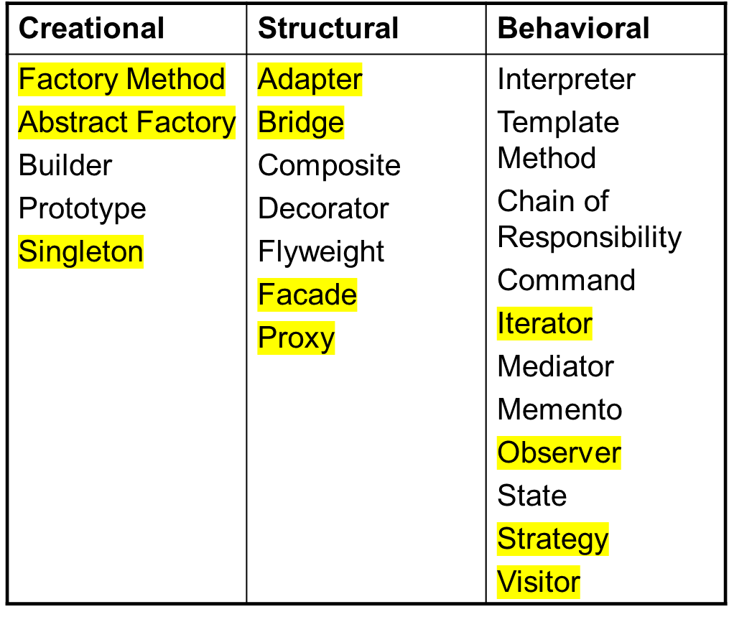
Classification of GoF Design Pattern
© E. Gamma, R. Helm, R. Johnson, J. Vlissides and Addison-Wesley

Slide 9
Singleton (Creational)
This pattern involves a single class which is responsible to create an object while making sure that only single object gets created.
This class provides a way to access its only object which can be accessed directly without need to instantiate the object of the class.

Slide 10
Singleton (Creational)
Intent
  Ensure a class only ever has one instance, and provide a global point of access to it.
Applicability
  When there must be exactly one instance of a class, and it must be accessible from a well-known access point
  When the sole instance should be extensible by subclassing, and clients should be able to use an extended instance without modifying their code
© E. Gamma, R. Helm, R. Johnson, J. Vlissides and Addison-Wesley

Slide 11
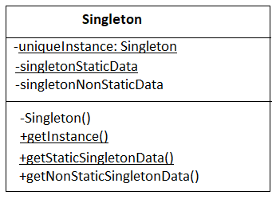
Singleton (cont'd)
Structure

Slide 12
Singleton (cont'd)
Consequences
  Reduces namespace pollution
  Makes it easy to change your mind and allow more than one instance
  Allow extension by subclassing
  Same drawbacks of a global if misused
  Implementation may be less efficient than a global
  Concurrency pitfalls
Implementation
  Static instance operation
  Registering the singleton instance
© E. Gamma, R. Helm, R. Johnson, J. Vlissides and Addison-Wesley

Slide 13
Singleton (cont'd)
Known Uses
  OS
  Print Task Manager

Slide 14
Singleton – Java Example
We're going to create a SingleObject class. SingleObject class have its constructor as private and have a static instance of itself.
SingleObject class provides a static method to get its static instance to outside world. SingletonPatternDemo, our demo class will use SingleObject class to get a SingleObject object.

Slide 15
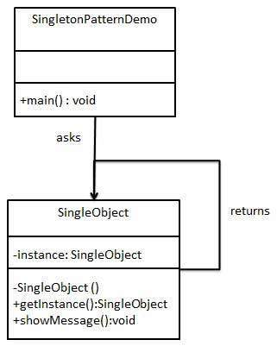
Singleton – Java Example

Slide 16
Singleton – Java Example
Step 1 : Create a Singleton Class SingleObject.java
public class SingleObject {
//create an object of SingleObject
private static SingleObject instance = new SingleObject();
//make the constructor private so that this class cannot be
//instantiated
private SingleObject(){}
//Get the only object available
public static SingleObject getInstance(){
return instance;
}
public void showMessage(){
System.out.println("Hello World!");
}
}

Slide 17
Singleton – Java Example
Step 2: Get the only object from the singleton class SingletonPatternDemo.java
public class SingletonPatternDemo {
public static void main(String[] args) {
//illegal construct
//Compile Time Error: The constructor SingleObject() is not visible
//SingleObject object = new SingleObject();
//Get the only object available
SingleObject object = SingleObject.getInstance();
//show the message
object.showMessage();
}
}

Slide 18
Singleton – Java Example
public class Singleton {
private static Singleton instance = new Singleton();
private int counter = 0;
private Singleton(){
}
public static Singleton getInstance(){
return instance;
}
public void incrementCounter(){
counter++;
}
public int getCounter(){
return counter;
}
}

Slide 19
Singleton - Example
Output:
Counter: 1
Counter: 2
Counter: 3
Counter: 4
Counter: 5
Singleton Class accessed from different Class and Object...
Counter: 6
Counter: 7
Counter: 8
Counter: 9
Counter: 10
public class SingletonDriver {
public static void main(String[] args) {
// TODO code application logic here
Singleton singleton = Singleton.getInstance();
for(int ndx = 0;ndx < 5; ndx++){
singleton.incrementCounter();
System.out.printf("Counter: %d\n", singleton.getCounter());
}
Singleton2ndDriver main2 = new Singleton2ndDriver();
main2.myMain();
}
}

Slide 20
Model and View
model: classes in your system that are related to the internal representation of the state of the system
  often part of the model is connected to file(s) or database(s)
  examples (card game): Card, Deck, Player
  examples (bank system): Account, User, UserList
view: classes in your system that display the state of the model to the user
  generally, this is your GUI (could also be a text UI)
  should not contain crucial application data
  Different views can represent the same data in different ways
    Example: Bar chart vs. pie chart
  examples: PokerPanel, BankApplet

Slide 21
Model-view-controller
model-view-controller (MVC): common design paradigm for graphical systems
controller: classes that connect model and view
  defines how user interface reacts to user input (events)
  receives messages from view (where events come from)
  sends messages to model (tells what data to display)
  sometimes part of view (see left)
data for rendering
View
Component
Model
View
Model
events
Controller
updates
Controller

Slide 22
Model / view / controller (MVC)
View
(displays data)
{
Model m;
Controller c(&m);
View v(&c);
}
Controller
(mediates)
Model
(holds data)
calls Register()
Main
Create()
View
Create()
Create()
Register()
Controller
Model

Slide 23
MVC – Java Example
We are going to create a Student object acting as a model.
StudentView will be a view class which can print student details on console.
StudentController is the controller class responsible to store data in Student object and update view StudentView accordingly.
MVCPatternDemo, our demo class, will use StudentController to demonstrate use of MVC pattern.

Slide 24
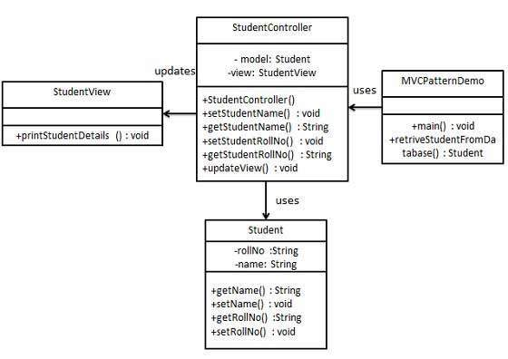
MVC – Java Example

Slide 25
MVC – Java Example
Step 1 : Create Model Student.java
public class Student {
private String rollNo;
private String name;
public String getRollNo() {
return rollNo;
}
public void setRollNo(String rollNo) {
this.rollNo = rollNo;
}
public String getName() {
return name;
}
public void setName(String name) {
this.name = name;
}
}

Slide 26
MVC – Java Example
Step 2: Create View StudentView.java
public class StudentView {
public void printStudentDetails(String studentName, String studentRollNo){
System.out.println("Student: ");
System.out.println("Name: " + studentName);
System.out.println("Roll No: " + studentRollNo);
}
}

Slide 27
MVC – Java Example
Step 3: Create Controller StudentController.java
public class StudentController {
private Student model;
private StudentView view;
public StudentController(Student model, StudentView view){
this.model = model;
this.view = view;
}
public void setStudentName(String name){
model.setName(name);
}
public String getStudentName(){
return model.getName();
}
public void setStudentRollNo(String rollNo){
model.setRollNo(rollNo);
}
public String getStudentRollNo(){
return model.getRollNo();
}
public void updateView(){
view.printStudentDetails(model.getName(), model.getRollNo());
}
}

Slide 28
MVC – Java Example
Step 4: Use the StudentController methods to demonstrate MVC design pattern usage: MVCPatternDemo.java
public class MVCPatternDemo {
public static void main(String[] args) {
//fetch student record based on his roll no from the database
Student model = retriveStudentFromDatabase();
//Create a view : to write student details on console
StudentView view = new StudentView();
StudentController controller = new StudentController(model, view);
controller.updateView();
//update model data
controller.setStudentName("John");
controller.updateView();
}
private static Student retriveStudentFromDatabase(){
Student student = new Student();
student.setName("Robert");
student.setRollNo("10");
return student;
}
}

Slide 29
Observer pattern
(Behavioral)
Observer pattern is one of the behavioral design patterns, which is useful when you are interested in the state of an object and want to get notified whenever there is any change.
In observer pattern, the objects that watch on the state of another object are called Observers and the object that is being watched is called Subject.
According to GoF, observer pattern intent is:
"Define a one-to-many dependency between objects so that when one object changes state, all its dependents are notified and updated automatically."

Slide 30
Observer pattern
(Behavioral)
observer: an object that "watches" the state of another object and takes action when the state changes in some way
  examples in Java: event listeners; java.util.Observer
observable object: an object that allows observers to examine it (often the observable object notifies the observers when it changes)
  permits customizable, extensible event-based behavior for data modeling and graphics

Slide 31
Observer
Intent
  Define a one-to-many dependency between objects so that when one object changes state, all its dependents are notified and updated automatically
Applicability
  When an abstraction has two aspects, one dependent on the other
  When a change to one object requires changing others, and you don't know how many objects need to be changed
  When an object should notify other objects without making assumptions about who these objects are
© E. Gamma, R. Helm, R. Johnson, J. Vlissides and Addison-Wesley

Slide 32
Observer
Java Message Service (JMS) uses Observer pattern along with Mediator pattern to allow applications to subscribe and publish data to other applications.
Model-View-Controller (MVC) frameworks also use Observer pattern where Model is the Subject and Views are observers that can register to get notified of any change to the model.

Slide 33
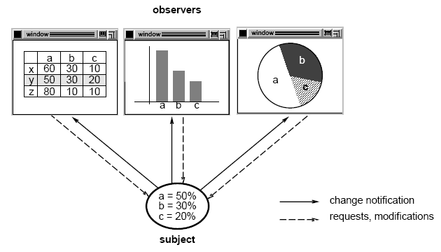
Subject-observer
[from Vlissides]

Slide 34
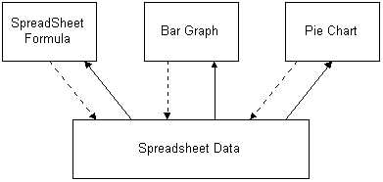
Schematic Observer Example
Observers
Subject

Slide 35
Subject-observer (cont.)
1
*
Subject
Register(Observer)
Unregister(Observer)
NotifyAll()
Observer
OnUpdate()
for all o in observers {
o.OnUpdate()
}

Slide 36
Subject-observer (cont.)
1
*
Subject
Register(Observer)
Unregister(Observer)
NotifyAll()
Observer
virtual OnUpdate()
for all o in observers {
o.OnUpdate()
}
ConcreteSubject
ConcreteObserver
virtual OnUpdate()

Slide 37
Observer (Cont'd)
Consequences
  Modularity: subject and observers may vary independently
  Extensibility: can define and add any number of observers
  Customizability: different observers provide different views of subject
  Unexpected updates: observers don't know about each other
  Update overhead: might need hints
Implementation
  Subject-observer mapping
  Dangling references
  Avoiding observer-specific update protocols: the push and push/pull models
  Registering modifications of interest explicitly
© E. Gamma, R. Helm, R. Johnson, J. Vlissides and Addison-Wesley

Slide 38
Observer (Cont'd)
Known uses
  Smalltalk model-view-controller (MVC)
  Interviews (subjects and views)
  Andrew (data objects and views)
Benefits
  Design reuse
  Uniform design vocabulary
  Enhance understanding, restructuring
  Basis for automation
© E. Gamma, R. Helm, R. Johnson, J. Vlissides and Addison-Wesley

Slide 39
Observer interface
package java.util;
public interface Observer {
public void update(Observable o, Object arg);
}
Idea: The update method will be called when the observable model changes, so put the appropriate code to handle the change inside update

Slide 40
Observable class
public void addObserver(Observer o)
public void deleteObserver(Observer o)
Adds/removes o to/from the list of objects that will be notified (via their update method) when notifyObservers is called.
public void notifyObservers()
public void notifyObservers(Object arg)
Inform all observers listening to this Observable object of an event that has occurred. An optional object argument may be passed to provide more information about the event.
public void setChanged()
Flags the observable object as having changed since the last event; must be called each time before calling notifyObservers.

Slide 41
Common usage of Observer
1. write a model class that extends Observable
  have the model notify its observers when anything significant happens
2. make all views of that model (e.g. GUI panels that draw the model on screen) into observers
  have the panels take action when the model notifies them of events (e.g. repaint, play sound, show option dialog, etc.)

Slide 42
Using multiple views
make an Observable model
write a View interface or abstract class
  make View an observer
extend/implement View for all actual views
  give each its own unique inner components and code to draw the model's state in its own way
provide mechanism in GUI to set view (perhaps through menus)
  to set view, attach it to observe the model

Slide 43
Observer Design Pattern
Implementation in Java
Observer pattern uses three actor classes. Subject, Observer and Client. Subject is an object having methods to attach and detach observers to a client object. We have created an abstract class Observer and a concrete class Subject that is extending class Observer.
ObserverPatternDemo, our demo class, will use Subject and concrete class object to show observer pattern in action.

Slide 44
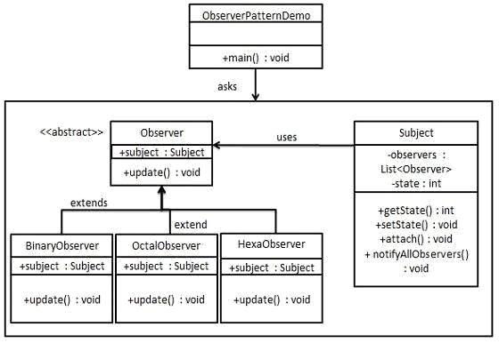
Observer Design Pattern
Implementation in Java

Slide 45
Observer Design Pattern
Implementation in Java
Step 1 Create Subject class: Subject.java
import java.util.ArrayList;
import java.util.List;
public class Subject {
private List<Observer> observers = new ArrayList<Observer>();
private int state;
public int getState() {
return state;
}

Slide 46
Observer Design Pattern
Implementation in Java
Step 1 Create Subject class.Subject.java
public void setState(int state) {
this.state = state;
notifyAllObservers();
}
public void attach(Observer observer){
observers.add(observer);
}
public void notifyAllObservers(){
for (Observer observer : observers) {
observer.update();
}
}

Slide 47
Observer Design Pattern
Implementation in Java
Step 2 Create Observer class.
Observer.java
public abstract class Observer {
protected Subject subject;
public abstract void update();
}

Slide 48
Observer Design Pattern
Implementation in Java
Step 3 Create concrete observer classes: BinaryObserver.java
public class BinaryObserver extends Observer{
public BinaryObserver(Subject subject){
this.subject = subject;
this.subject.attach(this);
}
@Override
public void update() {
System.out.println( "Binary String: " + Integer.toBinaryString( subject.getState() ) );
}
}

Slide 49
Observer Design Pattern
Implementation in Java
Step 3 Create concrete observer classes: OctalObserver.java
public class OctalObserver extends Observer{
public OctalObserver(Subject subject){
this.subject = subject;
this.subject.attach(this);
}
@Override
public void update() {
System.out.println( "Octal String: " + Integer.toOctalString( subject.getState() ) );
}
}

Slide 50
Observer Design Pattern
Implementation in Java
Step 3 Create concrete observer classes: HexaObserver.java
public class HexaObserver extends Observer{
public HexaObserver(Subject subject){
this.subject = subject;
this.subject.attach(this);
}
@Override
public void update() {
System.out.println( "Hex String: " + Integer.toHexString( subject.getState() ).toUpperCase() );
}
}

Slide 51
Observer Design Pattern
Implementation in Java
//Step 4 Use Subject and concrete observer objects.
//ObserverPatternDemo.java
public class ObserverPatternDemo {
public static void main(String[] args) {
Subject subject = new Subject();
new HexaObserver(subject);
new OctalObserver(subject);
new BinaryObserver(subject);
System.out.println("First state change: 15");
subject.setState(15);
System.out.println("Second state change: 10");
subject.setState(10);
}
}

Slide 52
Recap
Benefits of observer
abstract coupling between subject and observer; each can be extended and reused individually
dynamic relationship between subject and observer; can be established at run time (can "hot-swap" views, etc) gives a lot more programming flexibility
broadcast communication: notification is broadcast automatically to all interested objects that subscribed to it
Observer can be used to implement model-view separation in Java more easily

Slide 53
(Design) Pattern References
https://www.oodesign.com/
The Timeless Way of Building, Alexander; Oxford, 1979; ISBN 0-19-502402-8
A Pattern Language, Alexander; Oxford, 1977; ISBN 0-19-501-919-9
Design Patterns, Gamma, et al.; Addison-Wesley, 1995; ISBN 0-201-63361-2; CD version ISBN 0-201-63498-8
Pattern-Oriented Software Architecture, Buschmann, et al.; Wiley, 1996; ISBN 0-471-95869-7
Analysis Patterns, Fowler; Addison-Wesley, 1996; ISBN 0-201-89542-0
Smalltalk Best Practice Patterns, Beck; Prentice Hall, 1997; ISBN 0-13-476904-X
The Design Patterns Smalltalk Companion, Alpert, et al.; Addison-Wesley, 1998; ISBN 0-201-18462-1
AntiPatterns, Brown, et al.; Wiley, 1998; ISBN 0-471-19713-0

Slide 54
(Design) Pattern References
https://www.oodesign.com/
The Timeless Way of Building, Alexander; Oxford, 1979; ISBN 0-19-502402-8
A Pattern Language, Alexander; Oxford, 1977; ISBN 0-19-501-919-9
Design Patterns, Gamma, et al.; Addison-Wesley, 1995; ISBN 0-201-63361-2; CD version ISBN 0-201-63498-8
Pattern-Oriented Software Architecture, Buschmann, et al.; Wiley, 1996; ISBN 0-471-95869-7
Analysis Patterns, Fowler; Addison-Wesley, 1996; ISBN 0-201-89542-0
Smalltalk Best Practice Patterns, Beck; Prentice Hall, 1997; ISBN 0-13-476904-X
The Design Patterns Smalltalk Companion, Alpert, et al.; Addison-Wesley, 1998; ISBN 0-201-18462-1
AntiPatterns, Brown, et al.; Wiley, 1998; ISBN 0-471-19713-0

